Slide 1

Operating system (CS 311)

Slide 2
Overview
An OS acts as an intermediary between user and system hardware

Slide 3
What does an Operating system do?
S
Functions of Operating System
Processor management
Act as a Resource Manager
Memory Management
File Management
Security
Device Management
Input devices / Output devices Management
Deadlock Prevention
Time Management
Coordinate with system software or hardware

Slide 4
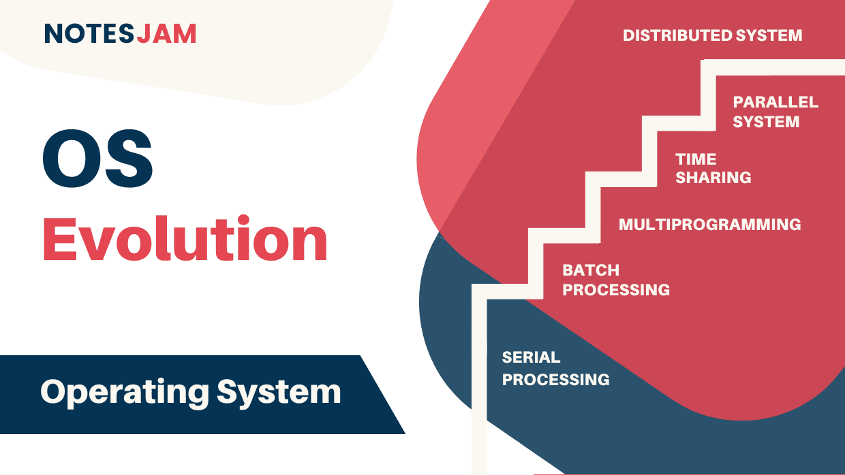
S

Slide 5
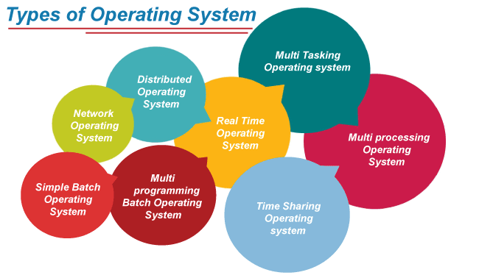
S

Slide 6
Serial Processing Operating System
S
History of the operating system started in 1950.
Before 1950, the programmers directly interact with the hardware there was no operating system at that time. If a programmer wishes to execute a program on those days, the following serial steps are necessary.
Type the program or punched card.
Convert the punched card to a card reader.
submit to the computing machine, is there any errors, the error was indicated by the lights.
The programmer examined the register and main memory to identify the cause of an error
Take outputs on the printers.
Then the programmer ready for the next progra

Slide 7
Batch Operating System
S
In the 1970s, Batch processing was very popular. In this technique, similar types of jobs were batched together and executed in time. People were used to having a single computer which was called a mainframe.
In Batch operating system, access is given to more than one person; they submit their respective jobs to the system for the execution.
The system put all of the jobs in a queue on the basis of first come first serve and then executes the jobs one by one. The users collect their respective output when all the jobs get executed

Slide 8
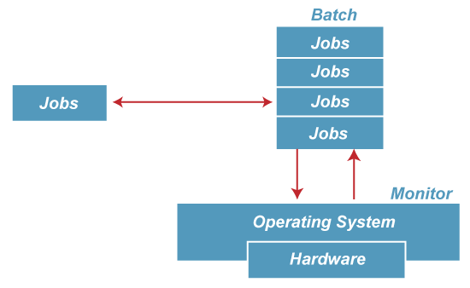
Batch Operating System
S
Advantages of Batch OS
The use of a resident monitor improves computer efficiency as it eliminates CPU time between two jobs.

Slide 9
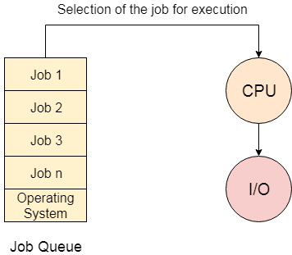
Batch Operating System
S
Disadvantages of Batch OS
Starvation
Batch processing suffers from starvation.
There are five jobs J1, J2, J3, J4, and J5, present in the batch. If the execution time of J1 is very high, then the other four jobs will never be executed, or they will have to wait for a very long time. Hence the other processes get starved.
2. Not Interactive
Batch Processing is not suitable for jobs that are dependent on the user's input.
If a job requires the input of two numbers from the console, then it will never get it in the batch processing scenario since the user is not present at the time of execution

Slide 10
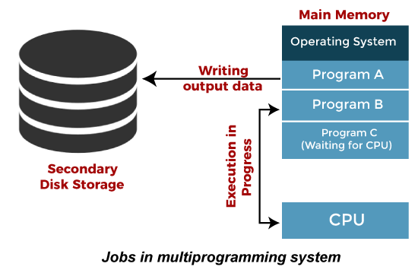
Multiprogramming Operating System
S
Multiprogramming is an extension to batch processing where the CPU is always kept busy. Each process needs two types of system time: CPU time and IO time.
In a multiprogramming environment, when a process does its I/O, The CPU can start the execution of other processes. Therefore, multiprogramming improves the efficiency of the system.

Slide 11
Multiprogramming Operating System
S
Advantages of Multiprogramming OS
Throughput the system is increased as the CPU always had one program to execute.
Response time can also be reduced.
Disadvantages of Multiprogramming OS
Multiprogramming systems provide an environment in which various systems resources are used efficiently, but they do not provide any user interaction with the computer system

Slide 12
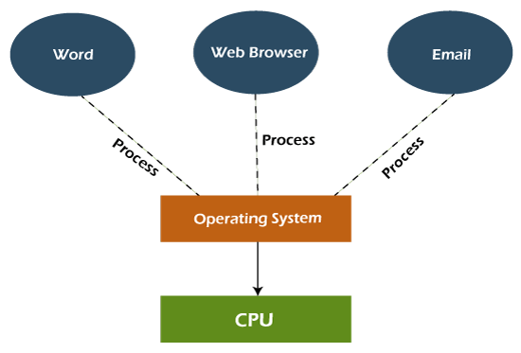
Multitasking Operating System
S
The multitasking operating system is a logical extension of a multiprogramming system that enables multiple programs simultaneously. It allows a user to perform more than one computer task at the same time.

Slide 13
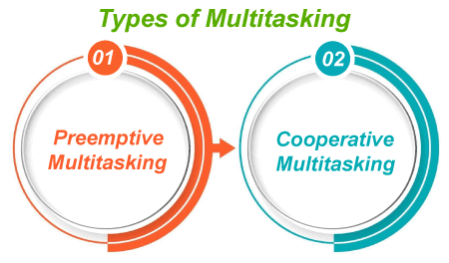
S
Advantages of Multitasking OS
This operating system is more suited to supporting multiple users simultaneously.
The multitasking operating systems have well-defined memory management.
Disadvantages of Multitasking OS
The multiple processors are busier at the same time to complete any task in a multitasking environment, so the CPU generates more heat.

Slide 14
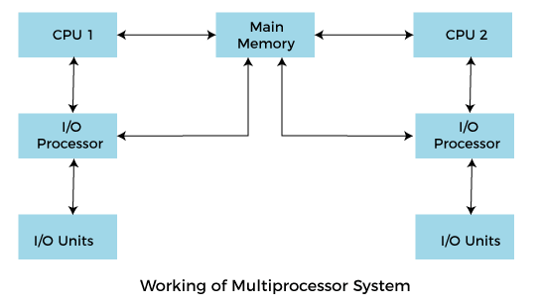
Multiprocessing Operating System
S
In Multiprocessing, Parallel computing is achieved.
There are more than one processors present in the system which can execute more than one process at the same time. This will increase the throughput of the system
More than one processor present in the system can execute more than one process simultaneously, which will increase the throughput of the system.

Slide 15
Multiprocessing Operating System
S
Advantages of Multiprocessing OS
Increased reliability: Due to the multiprocessing system, processing tasks can be distributed among several processors. This increases reliability as if one processor fails, the task can be given to another processor for completion.
Increased throughout: As several processors increase, more work can be done in less.
Disadvantages of Multiprocessing OS
Multiprocessing operating system is more complex and sophisticated as it takes care of multiple CPUs simultaneously.

Slide 16
 | Multiprogramming | Multitasking | Multiprocessing
Definition | Running multiple programs on a single CPU | Running multiple tasks simultaneously (via fast switching) | Using multiple CPUs/cores to execute multiple processes
Goal | Maximize CPU utilization | Improve system responsiveness | Enhance performance through parallel processing
CPU Count | Single | Single | Multiple
Execution Mode | One program at a time | Rapid context switching between tasks | True parallel execution of tasks
Concurrency | Pseudo-concurrent (simulated) | Pseudo-concurrent (simulated) | True concurrency
User Involvement | Mostly background processes | Interactive (user + background tasks) | Depends on system design, often background
Efficiency | Improves CPU utilization during I/O wait | Enhances user experience and CPU efficiency | Increases throughput and system reliability
Examples | Running compiler + printing simultaneously (on 1 CPU) | Typing a document while downloading a file | Video rendering while compiling code (on different CPUs)
OS Examples | Early UNIX, batch OS | Windows, Linux, macOS | Windows, Linux with multi-core processors

Slide 17
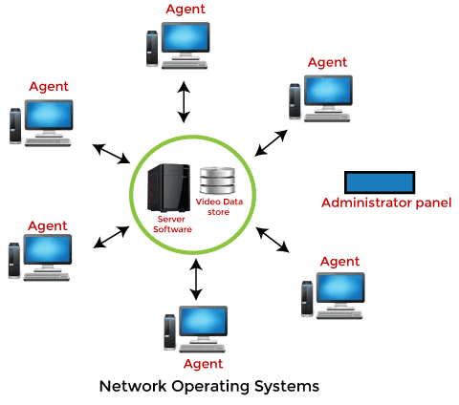
Network Operating System
S
An Operating system, which includes software and associated protocols to communicate with other computers via a network conveniently and cost-effectively, is called Network Operating System.

Slide 18
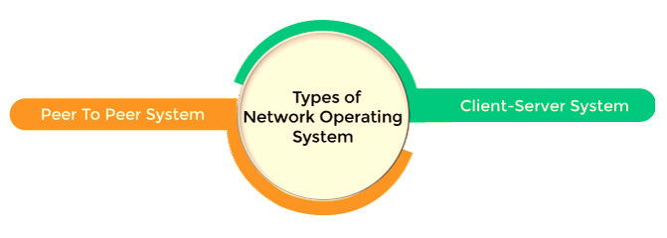
Network Operating System
S
Advantages of Network OS
In this type of operating system, network traffic reduces due to the division between clients and the server.
This type of system is less expensive to set up and maintain.
Disadvantages of Network OS
In this type of operating system, the failure of any node in a system affects the whole system.
Security and performance are important issues. So trained network administrators are required for network administration.

Slide 19
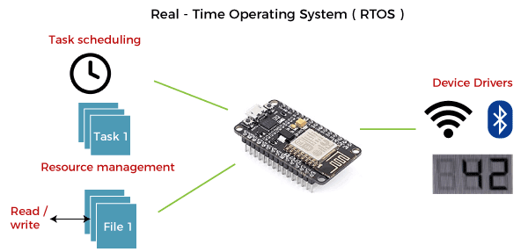
Real Time Operating System
S
In Real-Time Systems, each job carries a certain deadline within which the job is supposed to be completed, otherwise, the huge loss will be there, or even if the result is produced, it will be completely useless.
The Application of a Real-Time system exists in the case of military applications, if you want to drop a missile, then the missile is supposed to be dropped with a certain precision.

Slide 20
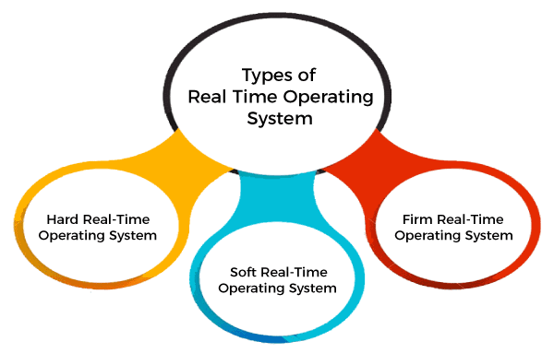
Real time Operating System
S
Advantages of Real time OS
Easy to layout, develop and execute real-time applications under the real-time operating system.
In a Real-time operating system, the maximum utilization of devices and systems.
Disadvantages of Real time OS
Real-time operating systems are very costly to develop.
Real-time operating systems are very complex and can consume critical CPU cycles.

Slide 21
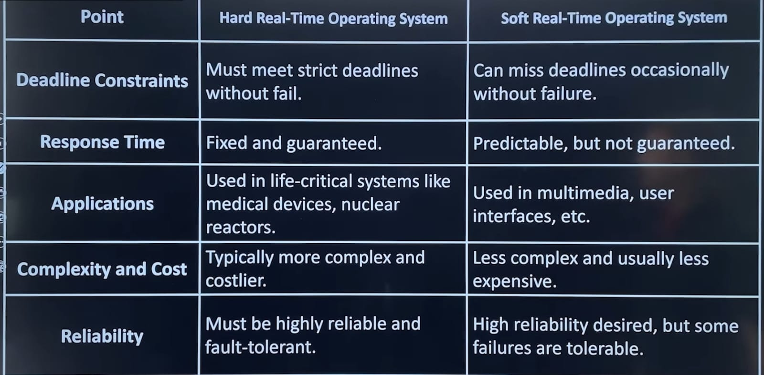

Slide 22
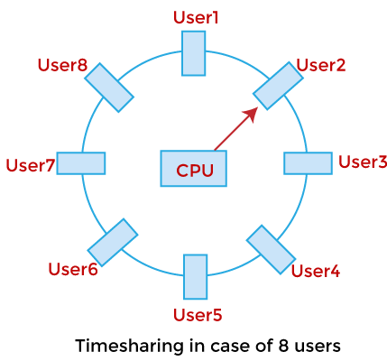
Time-Sharing Operating System
S
In the Time Sharing operating system, computer resources are allocated in a time-dependent fashion to several programs simultaneously.
Thus it helps to provide a large number of user's direct access to the main computer.
It is a logical extension of multiprogramming.
In time-sharing, the CPU is switched among multiple programs given by different users on a scheduled basis.

Slide 23
Time sharing Operating System
S
Advantages of Time Sharing OS
The time-sharing operating system provides effective utilization and sharing of resources.
This system reduces CPU idle and response time.
Disadvantages of Time Sharing OS
Data transmission rates are very high in comparison to other methods.
Security and integrity of user programs loaded in memory and data need to be maintained as many users access the system at the same time.

Slide 24
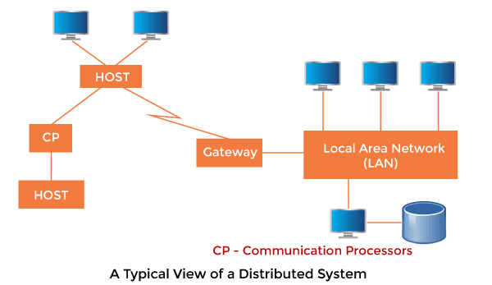
Distributed Operating System
S
The Distributed Operating system is not installed on a single machine, it is divided into parts, and these parts are loaded on different machines.
A part of the distributed Operating system is installed on each machine to make their communication possible.
Distributed Operating systems are much more complex, large, and sophisticated than Network operating systems because they also have to take care of varying networking protocols

Slide 25
Distributed Operating System
S
Advantages of Distributed OS
The distributed operating system provides sharing of resources.
This type of system is fault-tolerant
Disadvantages of Distributed OS
Protocol overhead can dominate computation cost.

Slide 26
 | Program | Process | Thread
Definition | A passive set of instructions (code) stored on disk | An active instance of a program in execution | A unit of execution within a process
State | Passive (not running) | Active (running in memory) | Active (running within a process)
Execution | Not executed directly | Executed independently, has its own memory space | Executed as part of a process, shares memory with other threads
Memory | Stored in secondary memory (e.g., hard disk) | Has its own address space | Shares address space with other threads in same process
Independence | Not independent, must be run to be useful | Independent from other processes | Not independent; part of a process
Communication | Programs don’t communicate | Inter-process communication (IPC) needed | Threads communicate via shared memory
Overhead | No runtime overhead | Higher (needs memory, resources, context switching) | Lower (lightweight, faster context switching)
Crash Impact | Cannot crash anything | If one process crashes, others are usually unaffected | If one thread crashes, it can bring down the entire process
ID | No ID | Has a Process ID (PID) | Has a Thread ID (TID)
Example | chrome.exe file on disk | Opening Chrome creates a process | Tabs or rendering engines in Chrome may run in separate threads

Slide 27
Thank You

